Slide 1
William Stallings
Data and Computer Communications
7th Edition
Chapter 21
Network Security

Slide 2
Security Requirements
Confidentiality
Integrity
Availability

Slide 3
Passive Attacks
Eavesdropping on transmissions
To obtain information
Release of message contents
  Outsider learns content of transmission
Traffic analysis
  By monitoring frequency and length of messages, even encrypted, nature of communication may be guessed
Difficult to detect
Can be prevented

Slide 4
Active Attacks
Masquerade
  Pretending to be a different entity
Replay
Modification of messages
Denial of service
Easy to detect
  Detection may lead to deterrent
Hard to prevent

Slide 5
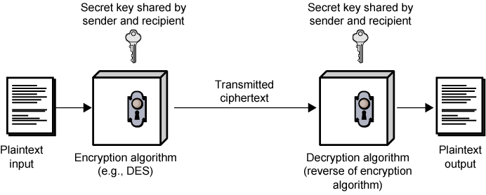
Symmetric Encryption (Simplified)

Slide 6
Ingredients
Plain text
Encryption algorithm
Secret key
Cipher text
Decryption algorithm

Slide 7
Requirements for Security
Strong encryption algorithm
  Even if known, should not be able to decrypt or work out key
  Even if a number of cipher texts are available together with plain texts of them
Sender and receiver must obtain secret key securely
Once key is known, all communication using this key is readable

Slide 8
Attacking Encryption
Crypt analysis
  Relay on nature of algorithm plus some knowledge of general characteristics of plain text
  Attempt to deduce plain text or key
Brute force
  Try every possible key until plain text is achieved

Slide 9
Algorithms
Block cipher
  Process plain text in fixed block sizes producing block of cipher text of equal size
  Data encryption standard (DES)
  Triple DES (TDES)
  Advanced Encryption Standard

Slide 10
Data Encryption Standard
US standard
64 bit plain text blocks
56 bit key
Broken in 1998 by Electronic Frontier Foundation
  Special purpose machine
  Less than three days
  DES now worthless

Slide 11
Triple DEA
ANSI X9.17 (1985)
Incorporated in DEA standard 1999
Uses 3 keys and 3 executions of DEA algorithm
Effective key length 112 or 168 bit
Slow
Block size (64 bit) too small

Slide 12
Advanced Encryption Standard
National Institute of Standards and Technology (NIST) in 1997 issued call for Advanced Encryption Standard (AES)
  Security strength equal to or better than 3DES
  Improved efficiency
  Symmetric block cipher
  Block length 128 bits
  Key lengths 128, 192, and 256 bits
  Evaluation include security, computational efficiency, memory requirements, hardware and software suitability, and flexibility
  2001, AES issued as federal information processing standard (FIPS 197)

Slide 13
AES Description
Assume key length 128 bits
Input is single 128-bit block
  Depicted as square matrix of bytes
  Block copied into State array
    Modified at each stage
  After final stage, State copied to output matrix
128-bit key depicted as square matrix of bytes
  Expanded into array of key schedule words
  Each four bytes
  Total key schedule 44 words for 128-bit key
Byte ordering by column
  First four bytes of 128-bit plaintext input occupy first column of in matrix
  First four bytes of expanded key occupy first column of w matrix

Slide 14
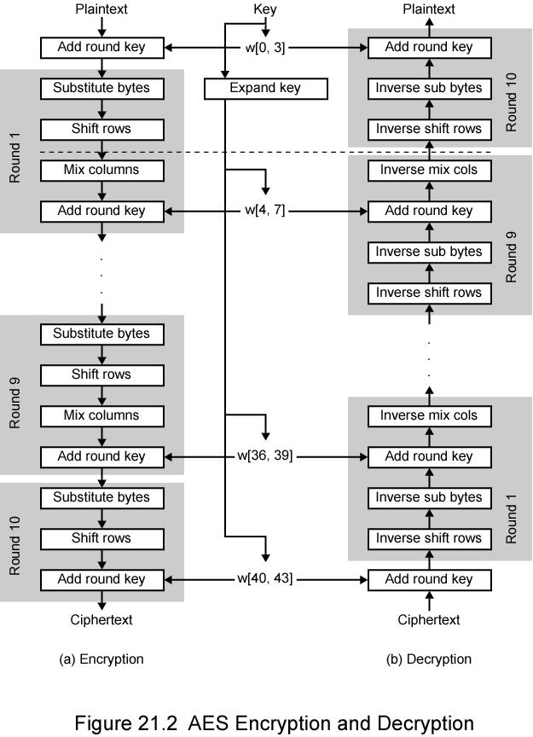
AES
Encryption and
Decryption

Slide 15
AES Comments (1)
Key expanded into array of forty-four 32-bit words, w[i]
  Four distinct words (128 bits) serve as round key for each round
Four different stages
  One permutation and three substitution
    Substitute bytes uses S-box table to perform byte-by-byte substitution of block
    Shift rows is permutation that performed row by row
    Mix columns is substitution that alters each byte in column as function of all of bytes in column
    Add round key is bitwise XOR of current block with portion of expanded key
Simple structure
  For both encryption and decryption, cipher begins with Add Round Key stage
  Followed by nine rounds,
    Each includes all four stages
  Followed by tenth round of three stages

Slide 16
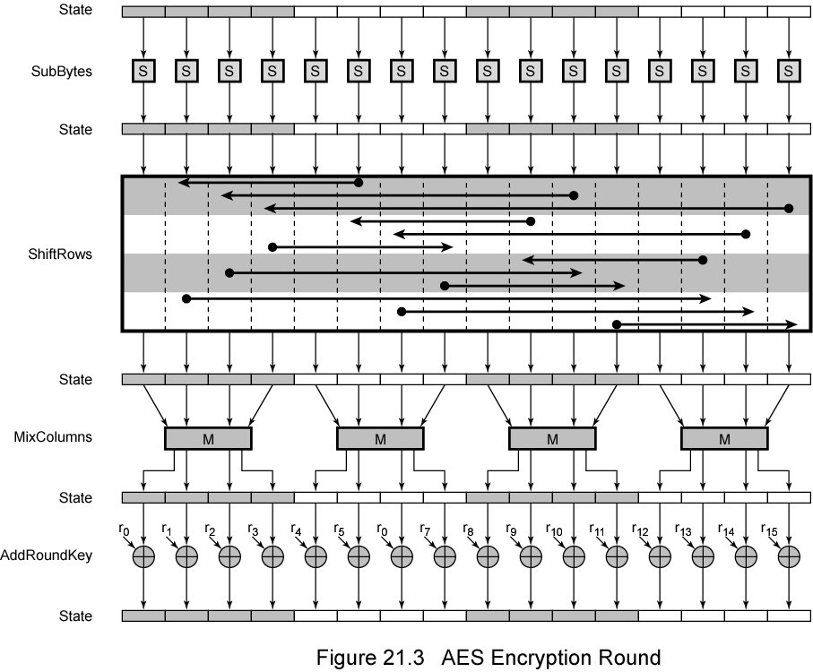
AES Encryption Round

Slide 17
AES Comments (2)
Only Add Round Key stage uses key
  Begin and ends with Add Round Key stage
  Any other stage at beginning or end, reversible without key
    Adds no security
Add Round Key stage by itself not formidable
  Other three stages scramble bits
  By themselves provide no security because no key
Each stage easily reversible
Decryption uses expanded key in reverse order
  Not identical to encryption algorithm
Easy to verify that decryption does recover plaintext
Final round of encryption and decryption consists of only three stages
  To make the cipher reversible

Slide 18
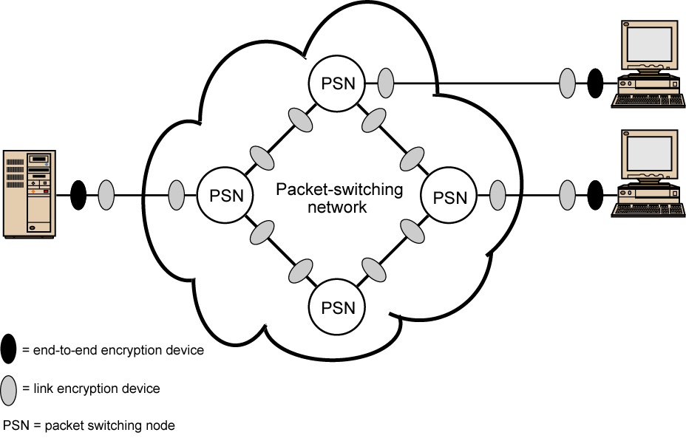
Location of Encryption Devices

Slide 19
Link Encryption
Each communication link equipped at both ends
All traffic secure
High level of security
Requires lots of encryption devices
Message must be decrypted at each switch to read address (virtual circuit number)
Security vulnerable at switches
  Particularly on public switched network

Slide 20
End to End Encryption
Encryption done at ends of system
Data in encrypted form crosses network unaltered
Destination shares key with source to decrypt
Host can only encrypt user data
  Otherwise switching nodes could not read header or route packet
Traffic pattern not secure
Use both link and end to end

Slide 21
Key Distribution
Key selected by A and delivered to B
Third party selects key and delivers to A and B
Use old key to encrypt and transmit new key from A to B
Use old key to transmit new key from third party to A and B

Slide 22
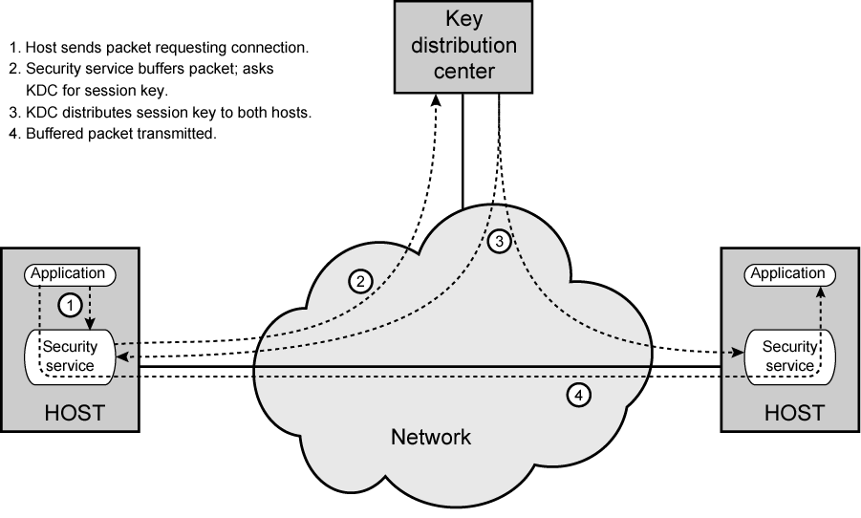
Automatic Key Distribution (diag)

Slide 23
Automatic Key Distribution
Session Key
  Used for duration of one logical connection
  Destroyed at end of session
  Used for user data
Permanent key
  Used for distribution of keys
Key distribution center
  Determines which systems may communicate
  Provides one session key for that connection
Security service module (SSM)
  Performs end to end encryption
  Obtains keys for host

Slide 24
Traffic Padding
Produce cipher text continuously
If no plain text to encode, send random data
Make traffic analysis impossible

Slide 25
Message Authentication
Protection against active attacks
  Falsification of data
  Eavesdropping
Message is authentic if it is genuine and comes from the alleged source
Authentication allows receiver to verify that message is authentic
  Message has not altered
  Message is from authentic source
  Message timeline

Slide 26
Authentication Using Encryption
Assumes sender and receiver are only entities that know key
Message includes:
  error detection code
  sequence number
  time stamp

Slide 27
Authentication Without Encryption
Authentication tag generated and appended to each message
Message not encrypted
Useful for:
  Messages broadcast to multiple destinations
    Have one destination responsible for authentication
  One side heavily loaded
    Encryption adds to workload
    Can authenticate random messages
  Programs authenticated without encryption can be executed without decoding

Slide 28
Message Authentication Code
Generate authentication code based on shared key and message
Common key shared between A and B
If only sender and receiver know key and code matches:
  Receiver assured message has not altered
  Receiver assured message is from alleged sender
  If message has sequence number, receiver assured of proper sequence

Slide 29
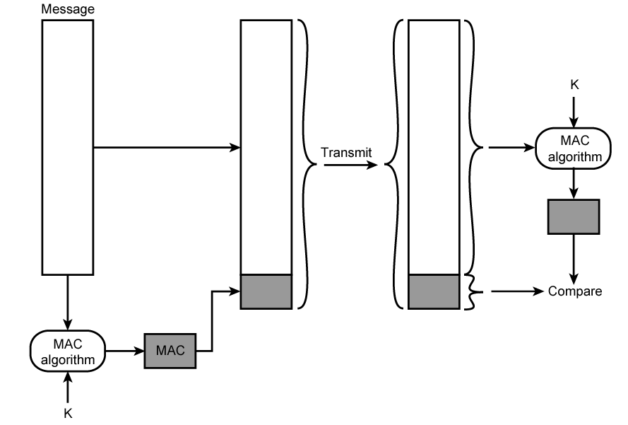
Message Authentication Using Message Authentication Code

Slide 30
One Way Hash Function
Accepts variable size message and produces fixed size tag (message digest)
Advantages of authentication without encryption
  Encryption is slow
  Encryption hardware expensive
  Encryption hardware optimized to large data
  Algorithms covered by patents
  Algorithms subject to export controls (from USA)

Slide 31
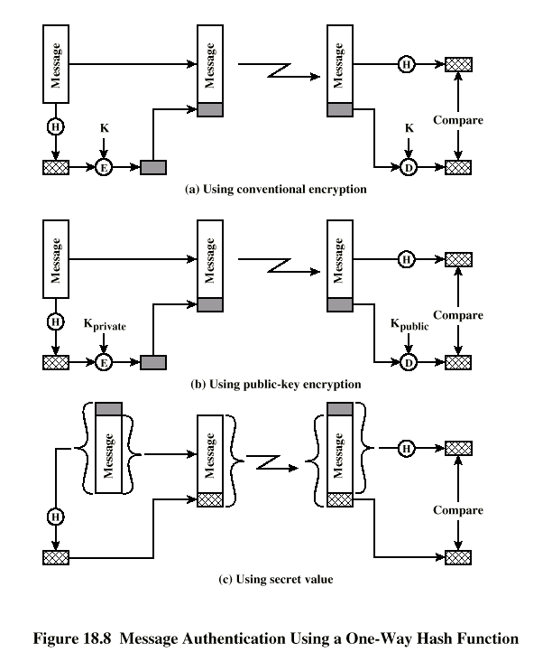
Using
One
Way
Hash

Slide 32
Secure Hash Functions
Hash function must have following properties:
  Can be applied to any size data block
  Produce fixed length output
  Easy to compute
  Not feasible to reverse
  Not feasible to find two message that give the same hash

Slide 33
SHA-1
Secure Hash Algorithm 1
Input message less than 2⁶⁴ bits
  Processed in 512 bit blocks
Output 160 bit digest

Slide 34
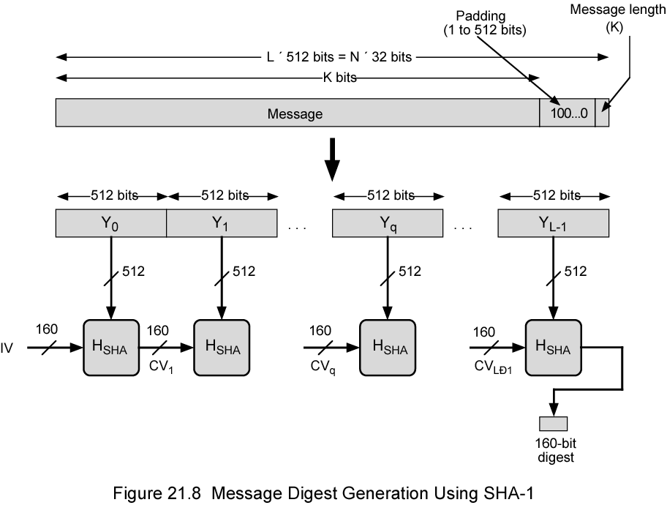
Message Digest Generation
Using SHA-1

Slide 35
Public Key Encryption
Based on mathematical algorithms
Asymmetric
  Use two separate keys
Ingredients
  Plain text
  Encryption algorithm
  Public and private key
  Cipher text
  Decryption algorithm

Slide 36
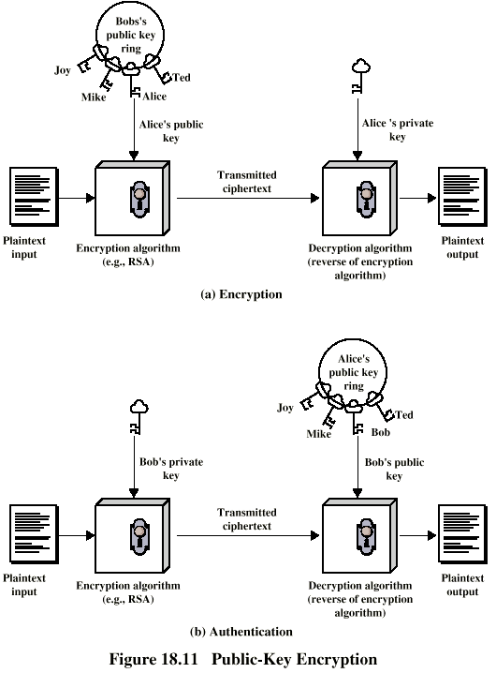
Public Key Encryption -
Encryption

Slide 37
Public Key Encryption –
Authentication

Slide 38
Public Key Encryption - Operation
One key made public
  Used for encryption
Other kept private
  Used for decryption
Infeasible to determine decryption key given encryption key and algorithm
Either key can be used for encryption, the other for decryption

Slide 39
Steps
User generates pair of keys
User places one key in public domain
To send a message to user, encrypt using public key
User decrypts using private key

Slide 40
Digital Signature
Sender encrypts message with their private key
Receiver can decrypt using sneders public key
This authenticates sender, who is only person who has the matching key
Does not give privacy of data
  Decrypt key is public

Slide 41
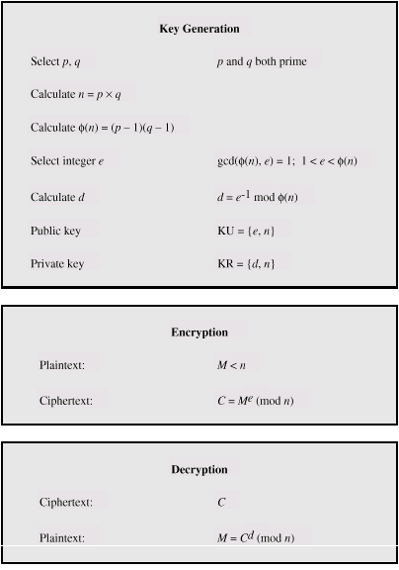
RSA Algorithm

Slide 42
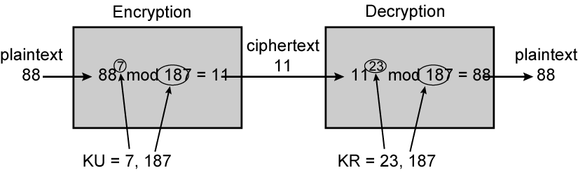
RSA Example

Slide 43
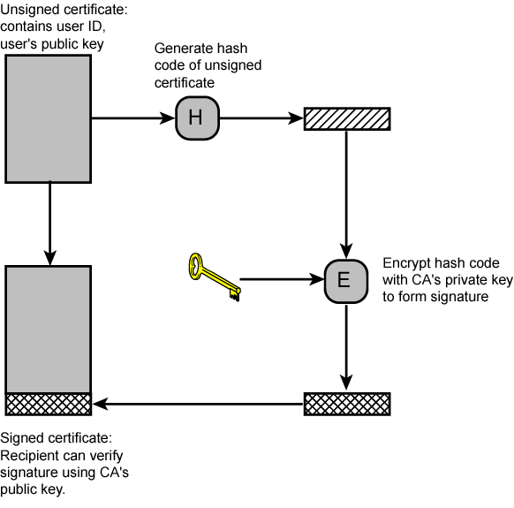
Public Key Certificate Use

Slide 44
Secure Sockets Layer
Transport Layer Security
Security services
Transport Layer Security defined in RFC 2246
SSL general-purpose service
  Set of protocols that rely on TCP
Two implementation options
  Part of underlying protocol suite
    Transparent to applications
  Embedded in specific packages
    E.g. Netscape and Microsoft Explorer and most Web servers
Minor differences between SSLv3 and TLS

Slide 45
SSL Architecture
SSL uses TCP to provide reliable end-to-end secure service
SSL two layers of protocols
Record Protocol provides basic security services to various higher-layer protocols
  In particular, HTTP can operate on top of SSL
Three higher-layer protocols
  Handshake Protocol
  Change Cipher Spec Protocol
  Alert Protocol
  Used in management of SSL exchanges (see later)

Slide 46
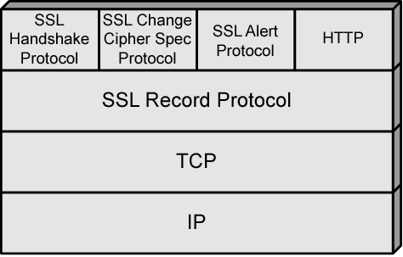
SSL Protocol Stack

Slide 47
SSL Connection and Session
Connection
  Transport that provides suitable type of service
  Peer-to-peer
  Transient
  Every connection associated with one session
Session
  Association between client and server
  Created by Handshake Protocol
  Define set of cryptographic security parameters
  Used to avoid negotiation of new security parameters for each connection
Maybe multiple secure connections between parties
May be multiple simultaneous sessions between parties
  Not used in practice

Slide 48
SSL Record Protocol
Confidentiality
  Handshake Protocol defines shared secret key
  Used for symmetric encryption
Message Integrity
  Handshake Protocol defines shared secret key
  Used to form message authentication code (MAC)
Each upper-layer message fragmented
  2¹⁴ bytes (16384 bytes) or less
Compression optionally applied
Compute message authentication code
Compressed message plus MAC encrypted using symmetric encryption
Prepend header

Slide 49
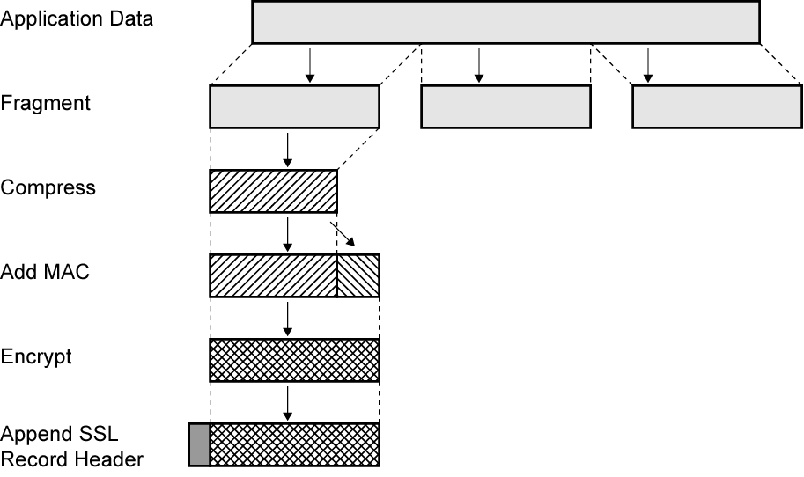
SSL Record Protocol Operation

Slide 50
Record Protocol Header
Content Type (8 bits)
  change_cipher_spec, alert, handshake, and application_data
  No distinction between applications (e.g., HTTP)
    Content of application data opaque to SSL
Major Version (8 bits) – SSL v3 is 3
Minor Version (8 bits) - SSLv3 value is 0
Compressed Length (16 bits)
  Maximum 2¹⁴ + 2048
Record Protocol then transmits unit in TCP segment
Received data are decrypted, verified, decompressed, and reassembled and then delivered

Slide 51
Change Cipher Spec Protocol
Uses Record Protocol
Single message
  Single byte value 1
Cause pending state to be copied into current state
  Updates cipher suite to be used on this connection

Slide 52
Alert Protocol
Convey SSL-related alerts to peer entity
Alert messages compressed and encrypted
Two bytes
  First byte warning(1) or fatal(2)
    If fatal, SSL immediately terminates connection
    Other connections on session may continue
    No new connections on session
  Second byte indicates specific alert
  E.g. fatal alert is an incorrect MAC
  E.g. nonfatal alert is close_notify message

Slide 53
Handshake Protocol
Authenticate
Negotiate encryption and MAC algorithm and cryptographic keys
Used before any application data sent

Slide 54
Handshake Protocol –
Phase 1 Initiate Connection
Version
  Highest SSL version understood by client
Random
  Client-generated random structure
  32-bit timestamp and 28 bytes from secure random number generator
  Used during key exchange to prevent replay attacks
Session ID
  Variable-length
  Nonzero indicates client wishes to update existing connection or create new connection on session
  Zero indicates client wishes to establish new connection on new session
CipherSuite
  List of cryptographic algorithms supported by client
  Each element defines key exchange algorithm and CipherSpec
Compression Method
  Compression methods client supports

Slide 55
Handshake Protocol –
Phase 2, 3
Client waits for server_hello message
  Same parameters as client_hello
Phase 2 depends on underlying encryption scheme
Final message in Phase 2 is server_done
  Required
Phase 3
  Upon receipt of server_done, client verifies certificate if required and check server_hello parameters
  Client sends messages to server, depending on underlying public-key scheme

Slide 56
Handshake Protocol –
Phase 4
Completes setting up
Client sends change_cipher_spec
Copies pending CipherSpec into current CipherSpec
  Not considered part of Handshake Protocol
  Sent using Change Cipher Spec Protocol
Client sends finished message under new algorithms, keys, and secrets
Finished message verifies key exchange and authentication successful
Server sends own change_cipher_spec message
Transfers pending to current CipherSpec
Sends its finished message
Handshake complete

Slide 57
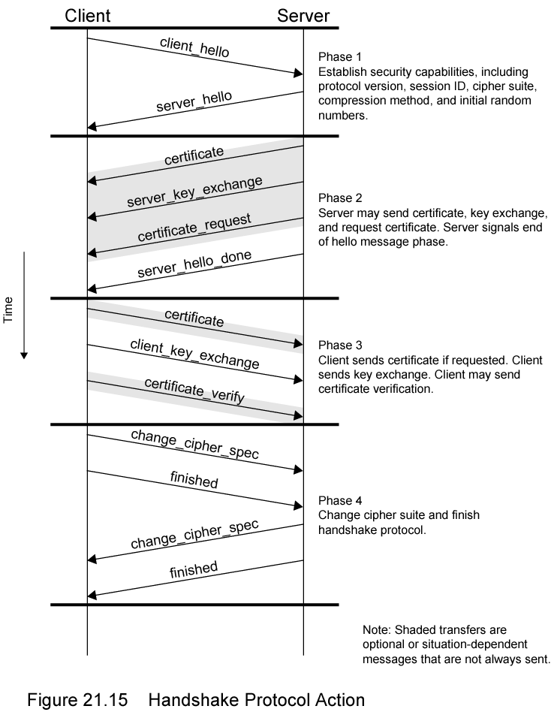
Handshake
Protocol
Action

Slide 58
IPv4 and IPv6 Security
IPSec
Secure branch office connectivity over Internet
Secure remote access over Internet
Extranet and intranet connectivity
Enhanced electronic commerce security

Slide 59
IPSec Scope
Authentication header
Encapsulated security payload
Key exchange
RFC 2401,2402,2406,2408

Slide 60
Security Association
One way relationship between sender and receiver
For two way, two associations are required
Three SA identification parameters
  Security parameter index
  IP destination address
  Security protocol identifier

Slide 61
SA Parameters
Sequence number counter
Sequence counter overflow
Anti-reply windows
AH information
ESP information
Lifetime of this association
IPSec protocol mode
  Tunnel, transport or wildcard
Path MTU

Slide 62
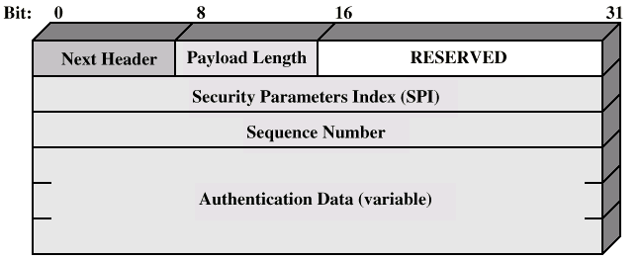
Authentication Header

Slide 63
Encapsulating Security Payload
ESP
Confidentiality services

Slide 64
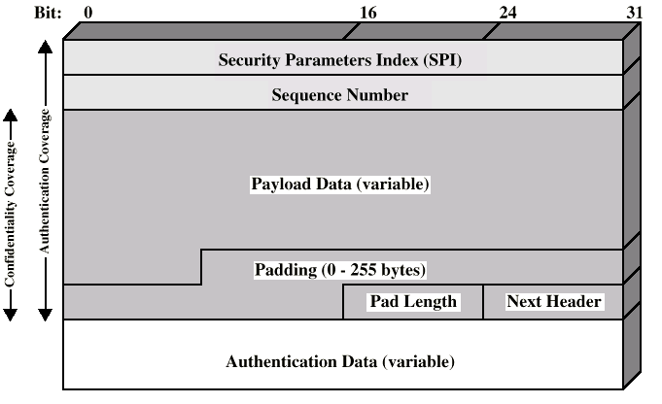
ESP Packet

Slide 65
Required Reading
Stallings chapter 21
Web sites on public/private key encryption
RFCs mentioned
  www.rfc-editor.org

